Slide 1
The Six Kingdoms

Slide 2
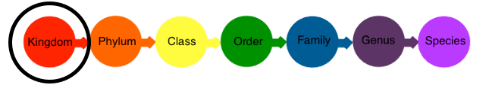
All organisms are classified on 7 levels, from kingdom down to species.
For example, all animals fit into the kingdom Animalia, but all humans are in just one species of animal, Homo sapiens.
There are 6 kingdoms of life which we will look at in this module. They are:
Animalia | Plantae | Fungi
Protista | Bacteria | Archaebacteria

Slide 3

Animalia is the animal kingdom. This is the one we and our pets belong to!
Animals are complex, multicellular organisms. They gain nutrition by eating other organisms, mainly plants and other animals.

Slide 4

Plantae is the plant kingdom, which includes the tiniest algae and the tallest trees!
Organisms in this kingdom gain nutrition from the sun, using the process of photosynthesis.
This gum tree (Eucalyptus tereticornis) is an example of a plant. It uses its green leaves to capture sunlight and make food for animals like the koala.

Slide 5

The Fungi kingdom contains mushrooms, toadstools and their relatives.
These organisms look similar to plants, but they don't have leaves, stems or flowers. They reproduce using spores and gain nutrition by breaking down (decomposing) dead organisms.

Slide 6
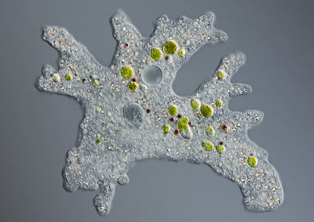
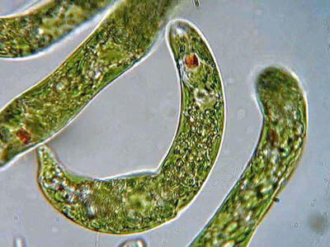
Now we get to the less familiar kingdoms of life. Kingdom Protista contains unicellular organisms.
Protists come in many shapes and get their energy in various ways. Some can swallow other cells (like Amoeba), while others use photosynthesis (like Euglena). They all store their DNA in a membrane-bound nucleus, just like the cells of animals, plants and fungi.

Slide 7
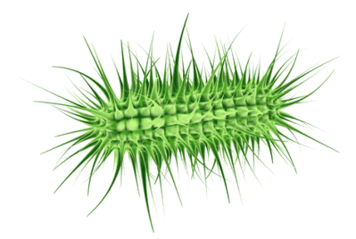
Many of the things you'd call "germs" are actually members of the Bacteria kingdom.
Some bacteria cause diseases like cholera, but others are good because they help animals like us to digest food.
Bacteria are unicellular organisms that do not have a membrane-bound nucleus. Their DNA is spread through their cells in circular chunks. Scientists call cells like these prokaryotes. They are the simplest and oldest form of life on Earth!

Slide 8
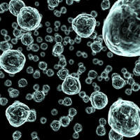
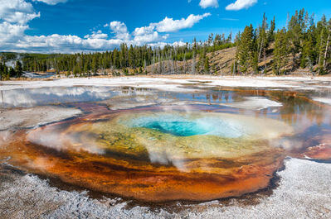
Archaebacteria (ar-kee-bacteria) is the sixth kingdom of life.
It contains unicellular organisms that look like bacteria but live in extreme conditions without oxygen.
While normal bacteria live almost anywhere, archaebacteria are found in harsh environments that are too salty, hot or acidic for anything else to grow. Some of them actually breathe acid

